Slide 1

Where is Wally?
3 June 2024

Slide 2
Welcome
Barend Lutz – CEO VoxCroft
Fred Lutz – COO VoxCroft
Trent Clarke – CTO VoxCroft
Best way to contact us is via email

Slide 3
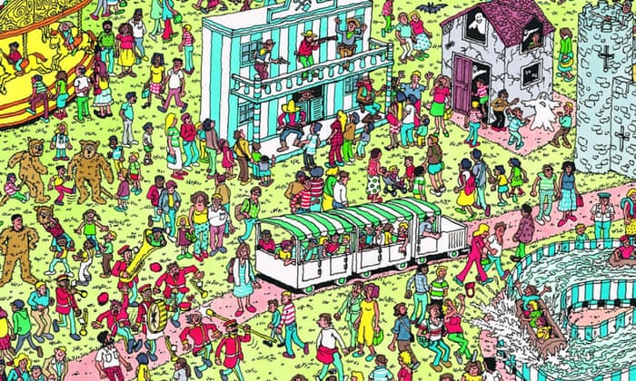

Slide 4
Agenda
Problem statement
Starter ideas
Delivery timelines

Slide 5
Problem statement
SCQARE
S = situation
C = concern
Q = question
A = answer / solution
R = rationale
E = ethical implications

Slide 6
Problem statement
Situation:
In our analysis, we want to know who is talking about who. Sometimes this is easy RT @FredLutz. Other times this is hard and confusing. 100s of articles referring to Biden, Joe Biden and Joseph Biden, is it the same person or not?
Raw material for the project: VoxCroft will provide them with lots of articles, with the entities extracted, both people and organizations (called actors from now on)
Concern:
We want to better understand who is being talked about, in a way that fairly represents the data, and provides the most clarity to analysts.

Slide 7
Problem statement
Question:
Create the best representation of the various actors in the data, in a way that helps analyst get an idea who the various actors – which are being talked about.
The aim is to help them rapidly understand and explore the data.

Slide 8
Problem statement
Answer (Solution):
You will be given a sample file raw data file to work with. In the last week, you will be given an additional ‘test’ files in a similar format, which will be used to see how well your system works.
Want a visually pleasing and scientifically accurate way of representing the data, having cleaned and matched it with the most likely pairings possible. This can be done in a BI tool, a website or even a Excel type presentation
Rationale / methodology:
You will need to describe the various steps you made to ensure that the actors are better represented.
What could you not solve, what future work would be needed?

Slide 9
Problem statement
Ethical considerations:
What ethical concerns do you have in the way you have done your processing? In what way are the following concerns addressed?
Utilitarianism - the greatest good for the greatest number of people (and minimize social injuries (Who is going to suffer? What is the pain?))
Duties and rights - we all have rights and with rights go duties (Is the action consistent with the moral rights of those whom it will affect?)
Justice - is the reward commensurate with contribution ( benefits valued against costs) (and is this distribution fair? Who will benefit most?
Caring - entitled to show more caring to people closer to you (especially those who are closely related to or dependent on oneself?)

Slide 10
Final delivery
Working solution
On the source data and on the test data
Presentation
Overview of the process
Description of the rational and ethical considerations
Suggestions of plans ahead, what could you not solve, what would you do if you had more time.

Slide 11

Starter ideas

Slide 12
Starter Ideas
Name cleanup – Joe Biden is the same as Biden, Joe
Proximity matching – Donald Trump is near Trump (so the same)
Wiki knowledge graphs – More likely that “Trump” = Donald than Peter Trump
Remember, the analysts can make sense of things
100% accurate not as important as understandably accurate
Depending on your skills, you could apply AI or ML to this.
If you just use LLM to try and resolve everything, this would be too costly. How would you manage that cost, are there alternatives you could give to use it less?

Slide 13
Name cleanup
Names extracted from articles | Count of times in all articles
Lutz | 1
Fred Lutz | 2
Barend | 3
Barend Lutz | 2
Fred | 1
Mr. Lutz | 3
Lutz, Fred | 1

Slide 14
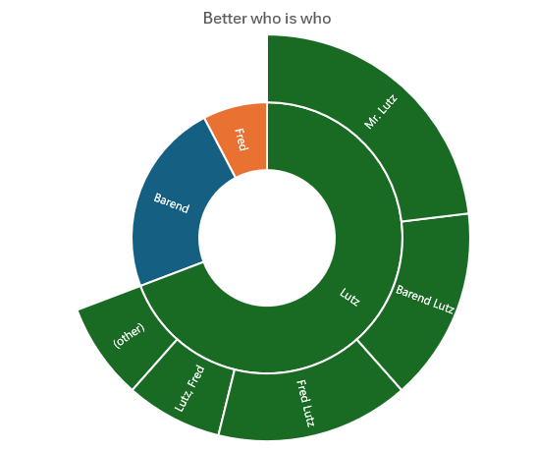
Improved
Name (Family/Single) | Name (Full) | Count of times in all articles
Barend |  | 3
Fred |  | 1
Lutz | (other) | 1
Lutz | Fred Lutz | 2
Lutz | Barend Lutz | 2
Lutz | Mr. Lutz | 3
Lutz | Lutz, Fred | 1

Slide 15
Even better
Name (Family /Single) | Name (Full) | Matched 'original name' | Reason | Count of times in all articles
Barend |  |  |  | 2
Fred |  |  |  | 1
Lutz | Barend Lutz | Barend | From same article, context shows same person | 1
Lutz | Barend Lutz |  |  | 2
Lutz | Barend Lutz | Mr. Lutz | From same article, context shows same person | 3
Lutz | Fred Lutz |  |  | 2
Lutz | Fred Lutz | Lutz, Fred | Edit name to consitent format (especially for easter names where surname is first) | 1
Lutz |  |  |  | 1

Slide 16
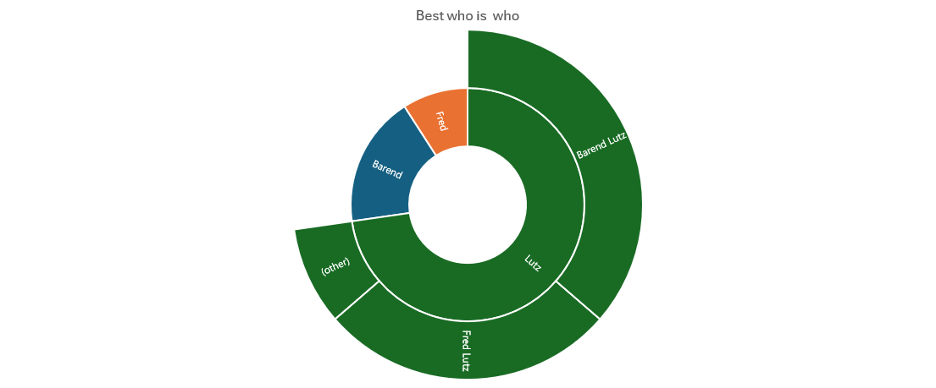
More improved?

Slide 17
Visualization
Platform
Website
BI tool
Excel
Questions to consider
Simple to represent 1 name family, how will you do it with many?
How will you let the analysts ‘explore’ the data?

Slide 18

Deliverable and due dates

Slide 19
Meetings
Monday meetings in person
Venture Workspace Claremont
Thursday check-in online
Via Google Meet

Slide 20

Timeframes
Thu. 6 June
Approach to data cleaning and matchings – what are you going to try?
Mon. 10 June
Questions and Small Wins feedback for data cleaning.
Choice of platform to present the answers
Mon. 17 June
Small Wins – results for data cleaning
Initial prototype of presentation platform
Mon. 24 June
Platform for delivery – internal delivery to Fred/Barend/Trent
Thu. – Fri. 27 June
28
Final demonstration to analyst team.

Slide 21

Good luck

